Slide 1
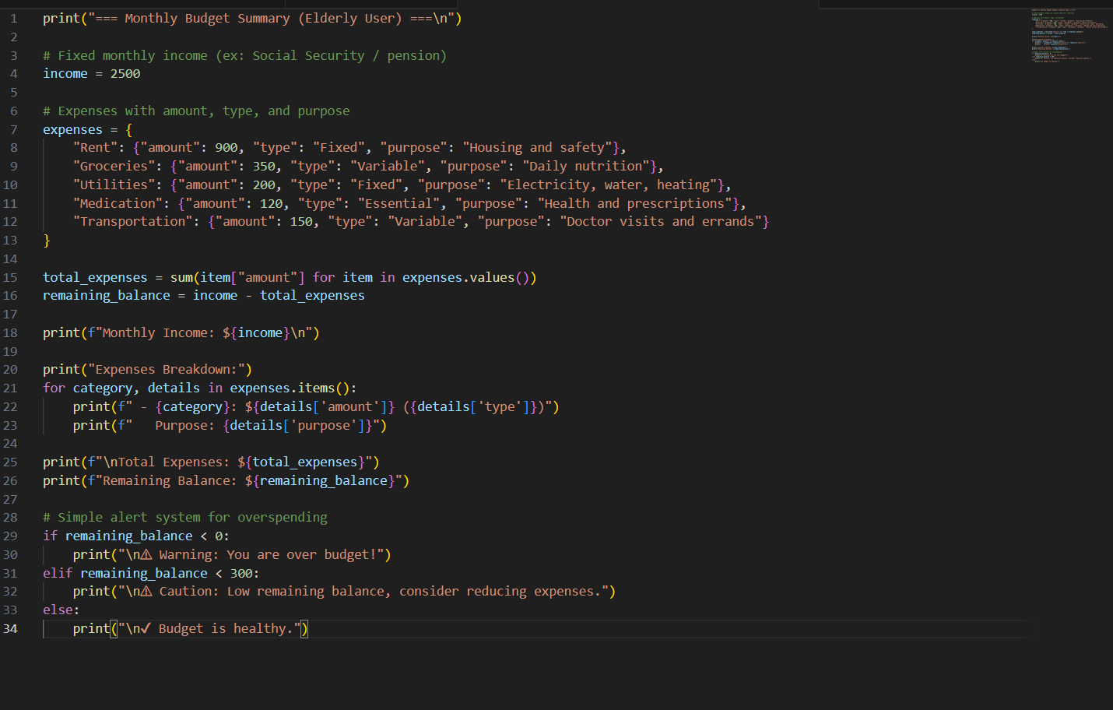
Simple Budgeting Software for Elderly Users
Team Members- Jalen Justice
Project overview
This Python-based budgeting application helps elderly users track income, manage expenses, and easily see their remaining balance using a simple and easy-to-understand design.
Key Features
Tracks income and expenses
Calculates remaining balance
Uses a simple layout
Designed for elderly users
Making money management simple, clear, and stress-free for seniors

